Slide 1



CS 327
IIT Gandhinagar
SeeSPIM Compiler
Project Presentation
Project Goals
Designing a Compiler in C that can run on simulators like SPIM & MARS
Aditya Tripathi 18110010
Devvrat Joshi 18110076 Kushagra Sharma 18110091
Nishikant Parmar 18110108
Thanks to Prof. Bireswar Das

Slide 2
Basic Features
Advanced Features
Advanced Control Flow Statements
break
continue
Recursive Functions and Dynamic Allocation
Extensive Error Handling
Break, continue, return type, variable or function declaration, input/output type checking, assignment type checking, array indices - integer, function calling, type checking - arithmetic operators, comparison operators, main function not declared, params passing errors, parse errors, total errors.
All errors are printed using specific message with line number and position.
Extra Data Types (Strings)
String declaration
Assignment (Right side static string or another string variable)
Mutation (Changing the ith index of the string)
Concatenation of two strings using + operator
String input and output
Single Dimensional Array
Can use any generic expressions for indexing
Multi Dimensional Array
Static integer for indexing
Newline Function
Function that prints a newline when called
Parameter passing to functions
Ternary Operators
Complete scope maintenance
Data Types
Declaration of Variables
Conditional Statements
Relational Operators
Boolean Operators
Unary Operators
Arithmetic Operators
Assignment Operator
For Loop
While Loop
Control Flow Statements
Scope of Variables
Function Declaration
Function Calling
Input Function
Output Function

Slide 3
Techniques and New Ideas
Stack allocation is used for memory allocation. A stack pointer and a top of stack pointer are maintained throughout the assembly generation for each activation record
Parameter passing is done by placing the parameters on the activation record of the callee function, by the caller function. The return address is automatically linked to $ra via jal.
Strings defined in any function gets globally defined in .data section of mips code.
Assigning/copying a string is done by looping over the length of the strings.
For multi-dimensional array the array index is flattened and the array is treated like a static one dimensional array.
Type checking: Types are checked using their entry in symbol table for assignment, parameter passing, etc.
Error handling is done while parsing. This includes type checking, declaration checking etc.
Very basic register allocation is done. The registers are spilled into memory after any computation.

Slide 4
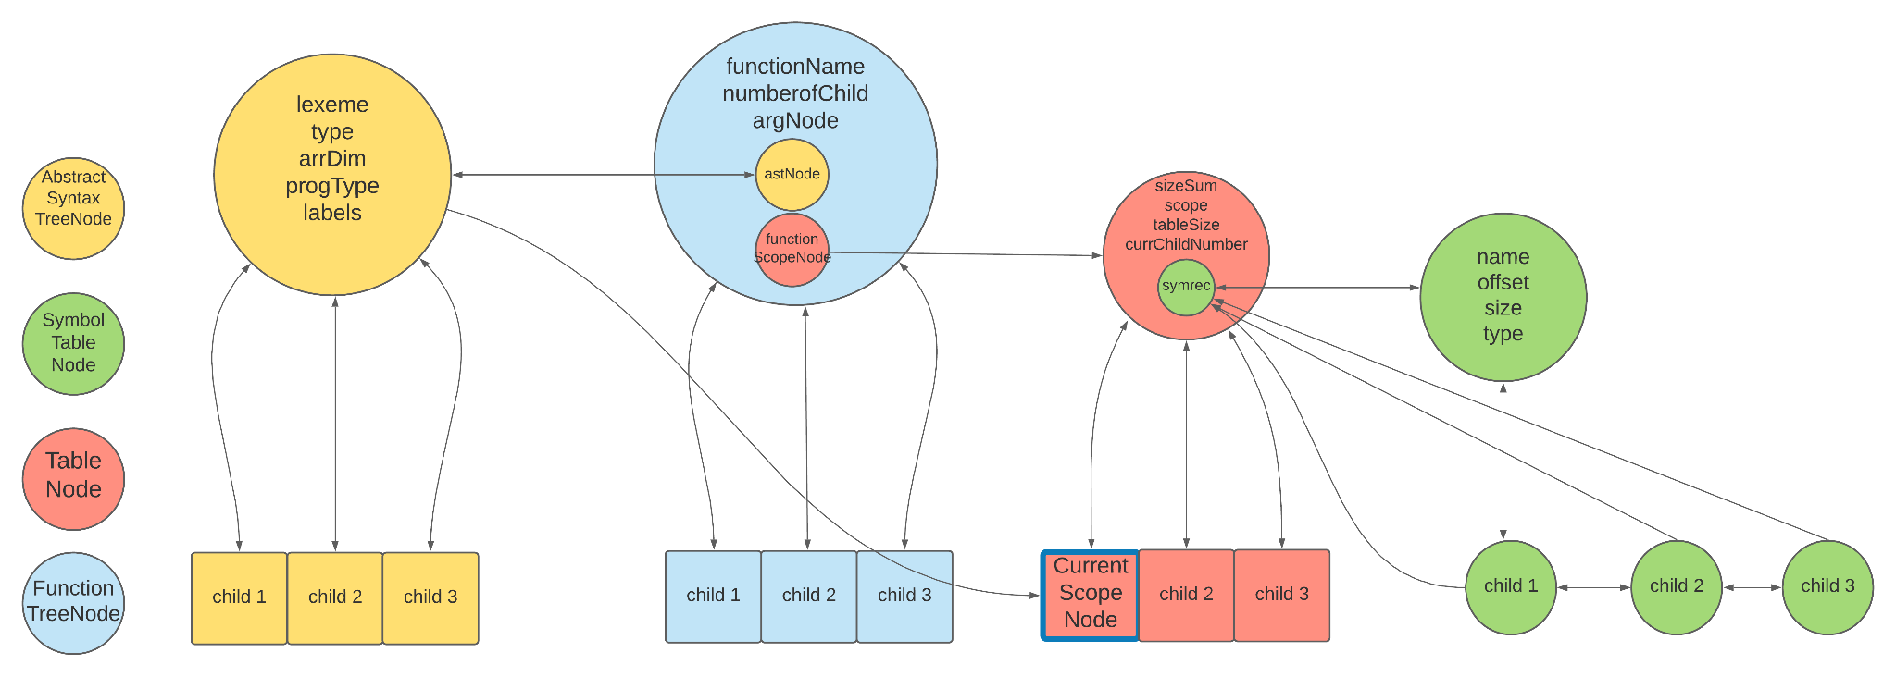
Scope is maintained using a data structure storing separate symbol tables for each scope.
The scope can change when:
A function starts/ends
A loop starts/ends
if-else statements start/end
Declaring blocks using { }
The scope checking would handle the accessibility of the string. All the constant strings are assigned a name and stored in .data section.

Slide 5
Thank You
References -
https://github.com/amankr/Mini-Compiler
For Logos and Graphic Icons used in slides - Google Images

